Slide 1

Automation Main Project – screenshots & Screen recording links
Sruthi P S
S11

Slide 2
Table of Contents
Modules
1. Compatibility / Cross browser testing Screen recording link: https://drive.google.com/file/d/1aTjbrCGjLAEGwWpcbqTGDEv50JO3KNOa/view?usp=drivesdk
2. Home page Screen recording link:
3. Register Screen recording link: https://drive.google.com/file/d/1VbmPlfCdS7GYey-xXN50jec2Vf80edkU/view?usp=drivesdk
4. Login Screen recording link: https://drive.google.com/file/d/1GAUiXtrSCWOeiWxKkMIkyd7dGOKXdSHk/view?usp=drivesdk
5. Set Goal Screen recording link: https://drive.google.com/file/d/1PYPBt0rUBQBaGMN1GzAHAcpgZAjreQsJ/view?usp=drivesdk
6. Apache JMeter performance and responsiveness testing Screen recording link:

Slide 3
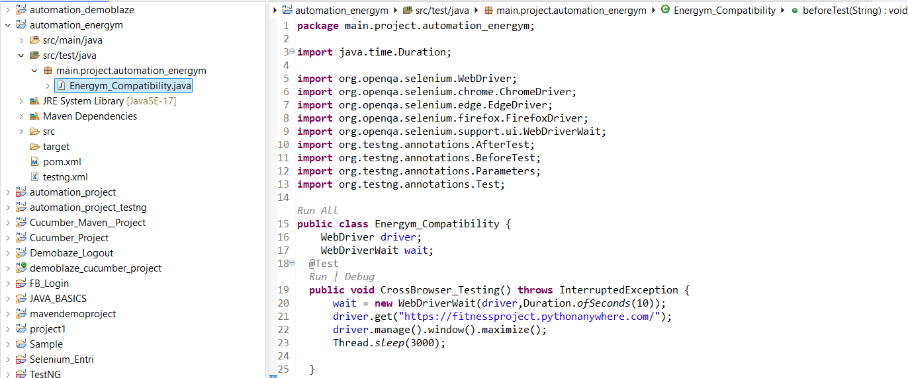
1. Compatibility Testing
.

Slide 4
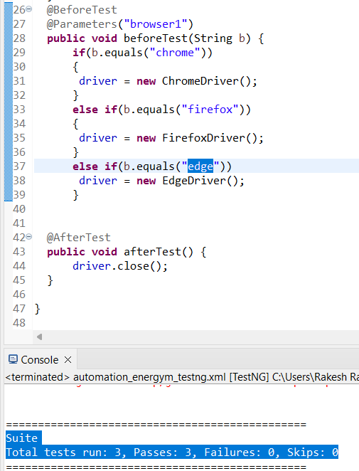
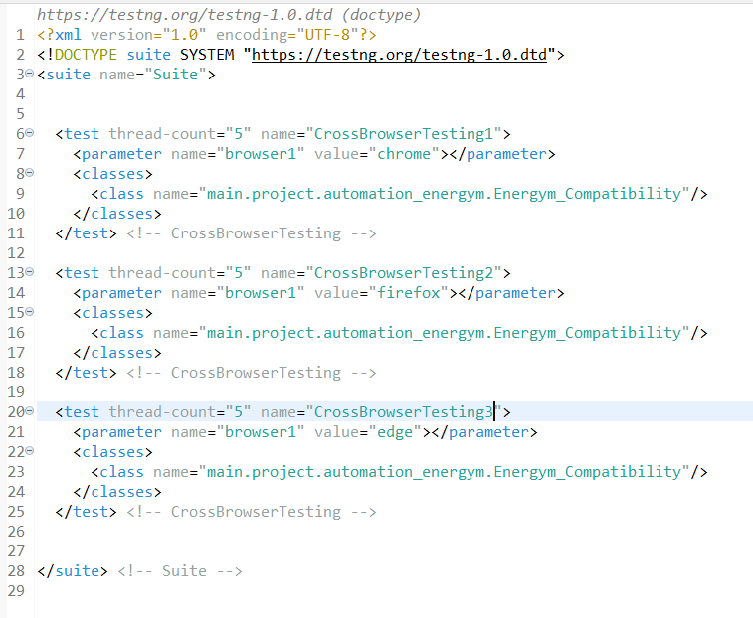

Slide 5
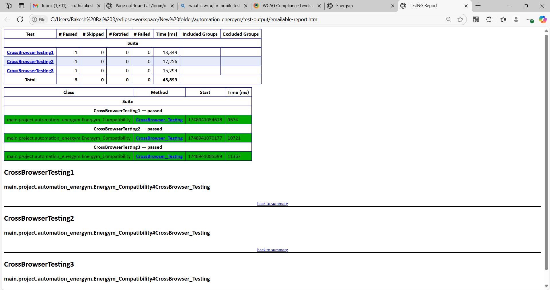
emailable-report.html

Slide 6
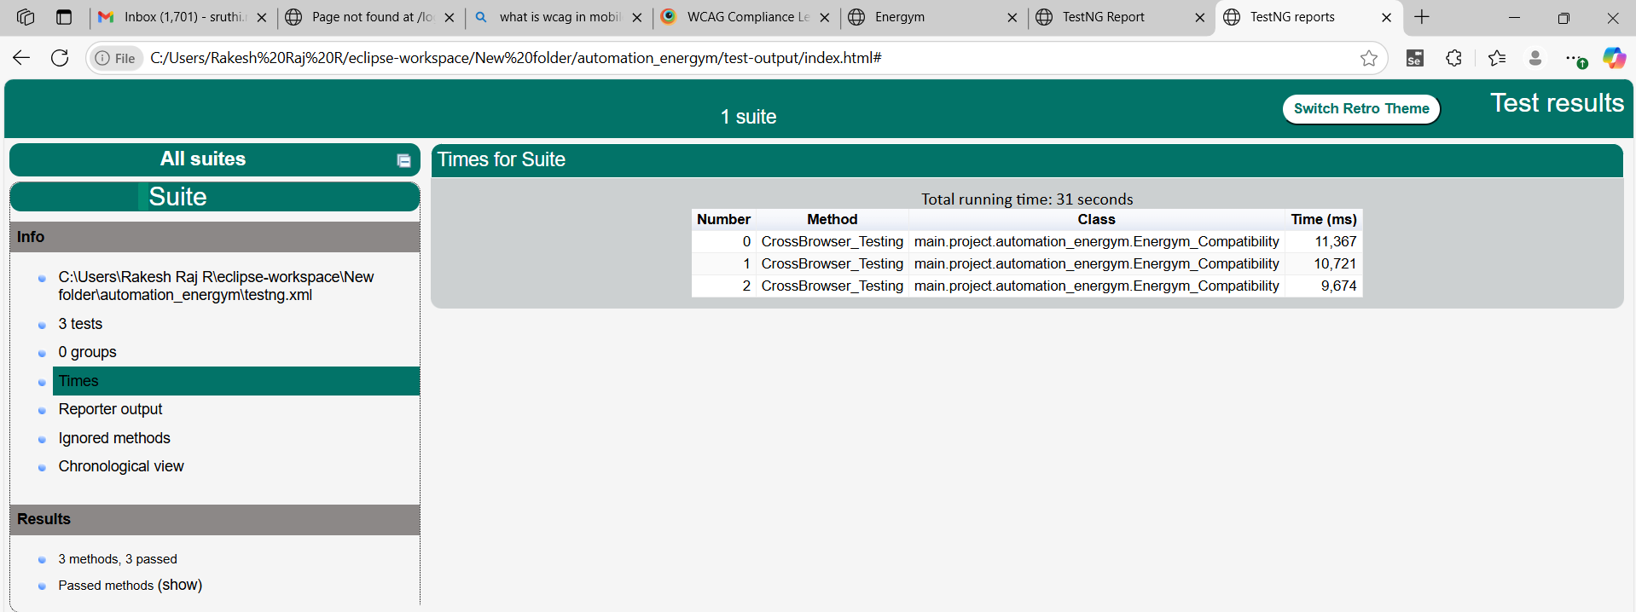
index.html

Slide 7
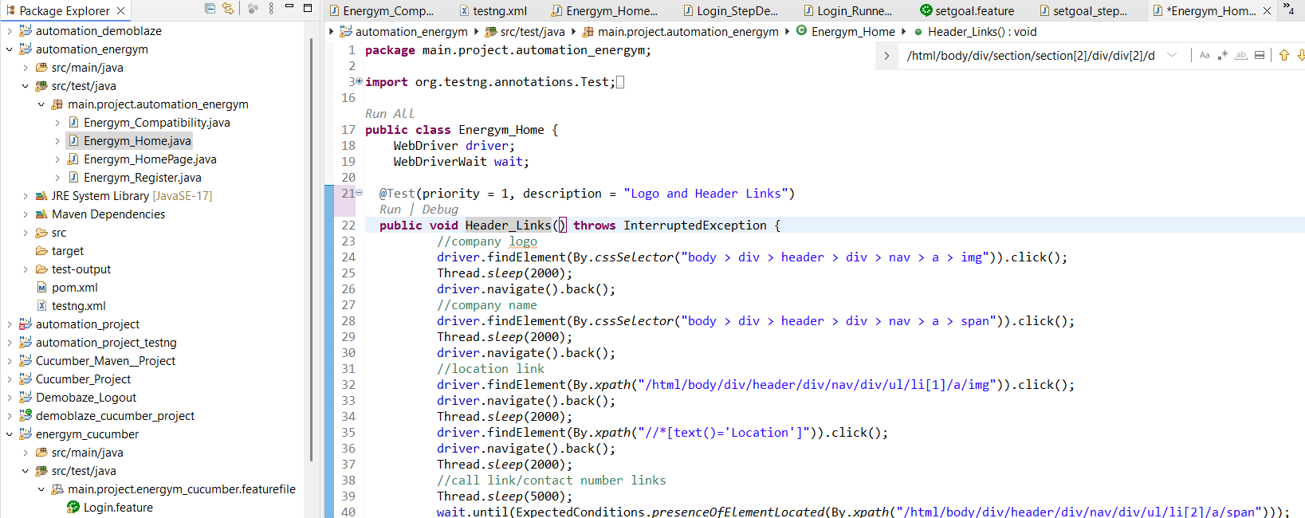
2. HOME PAGE

Slide 8
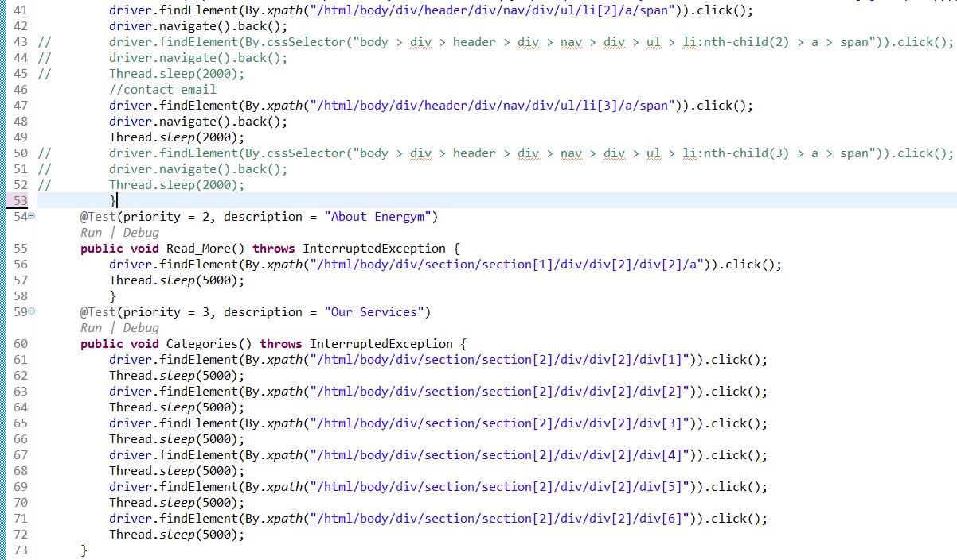

Slide 9
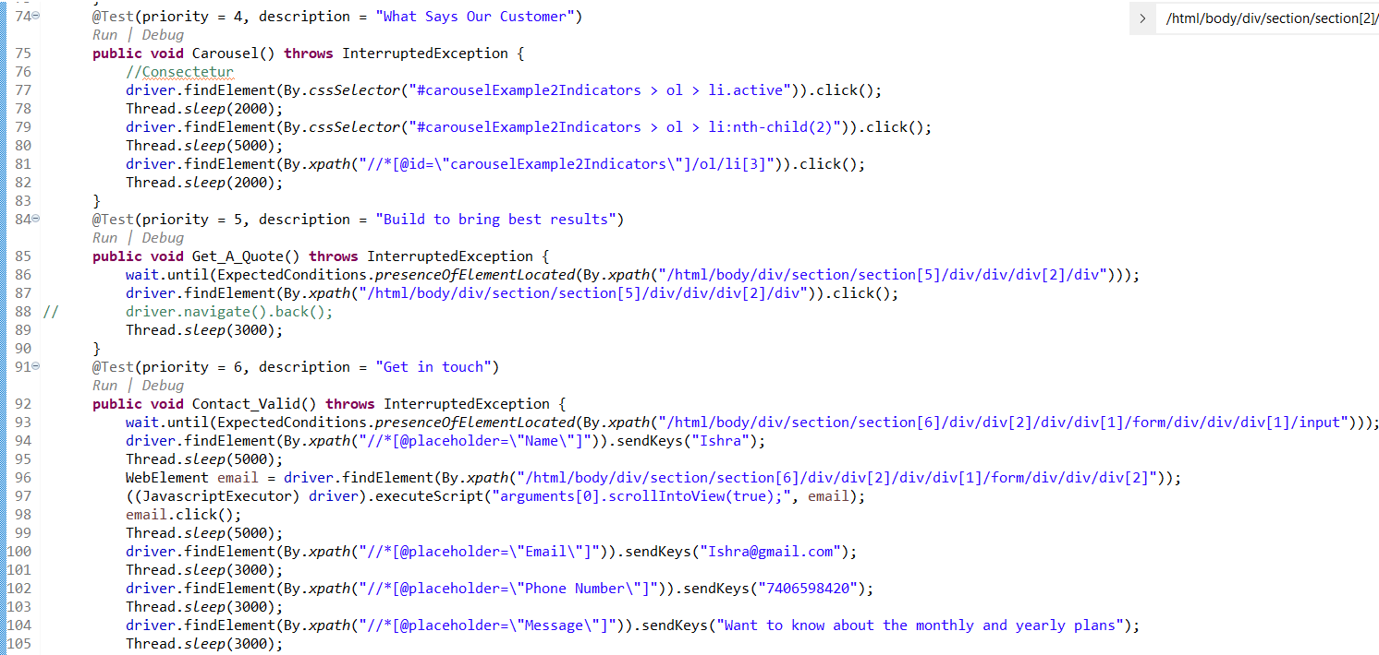

Slide 10
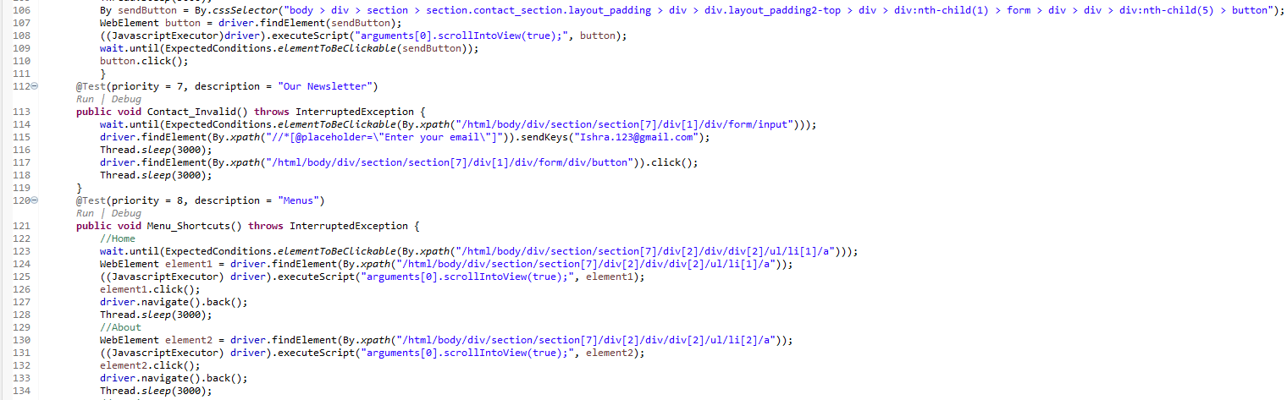

Slide 11
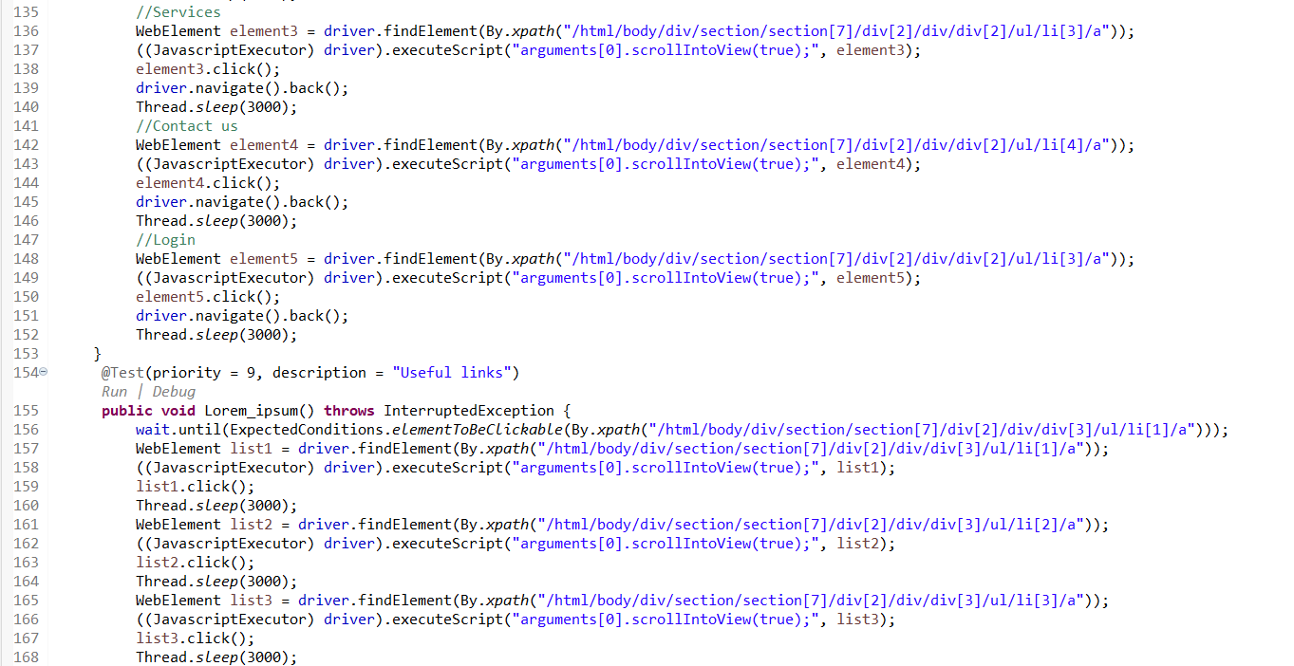

Slide 12
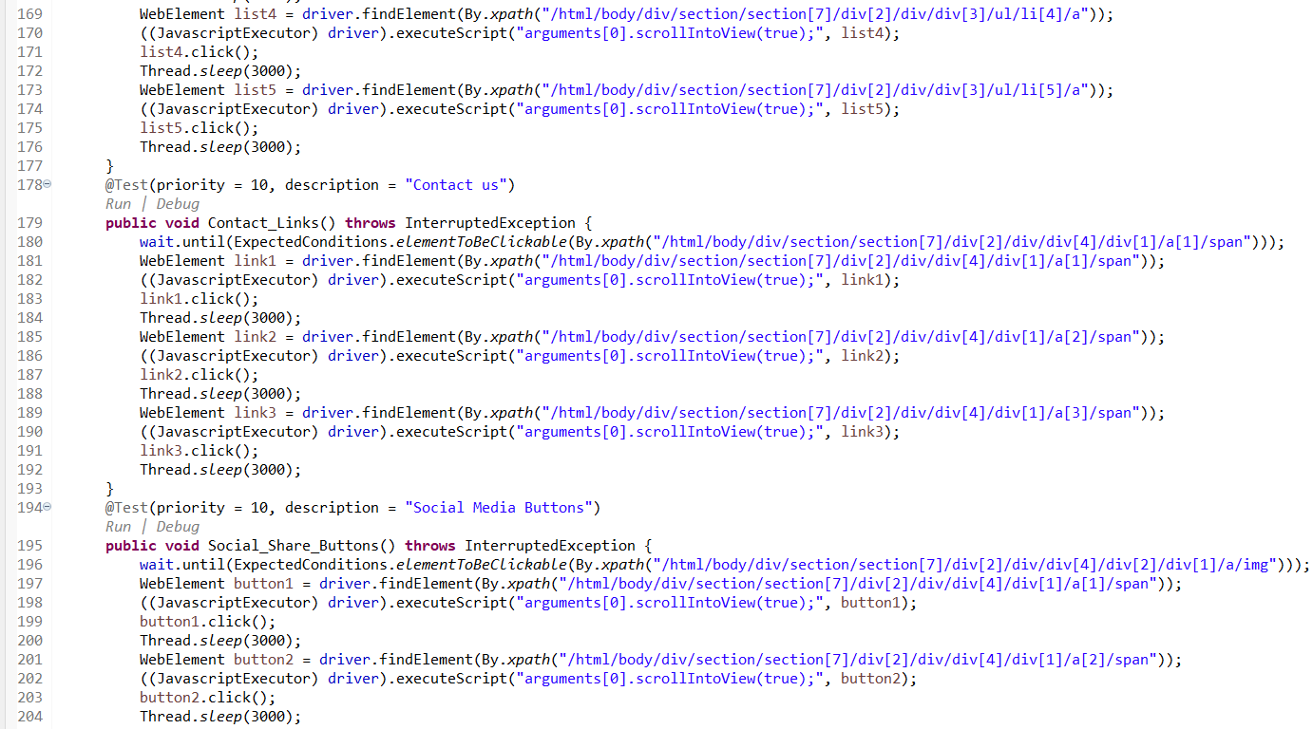

Slide 13
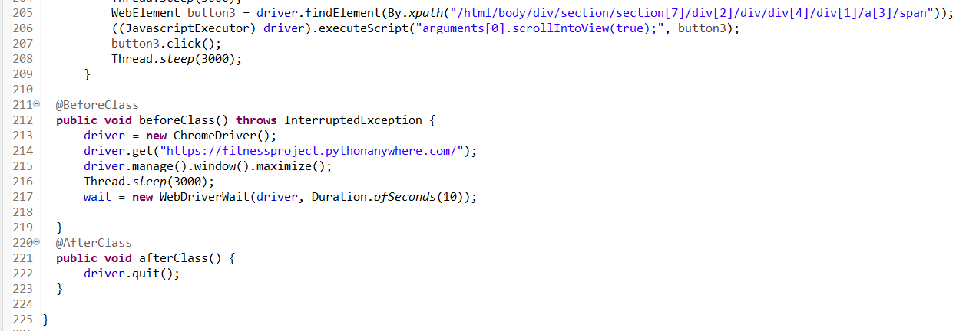
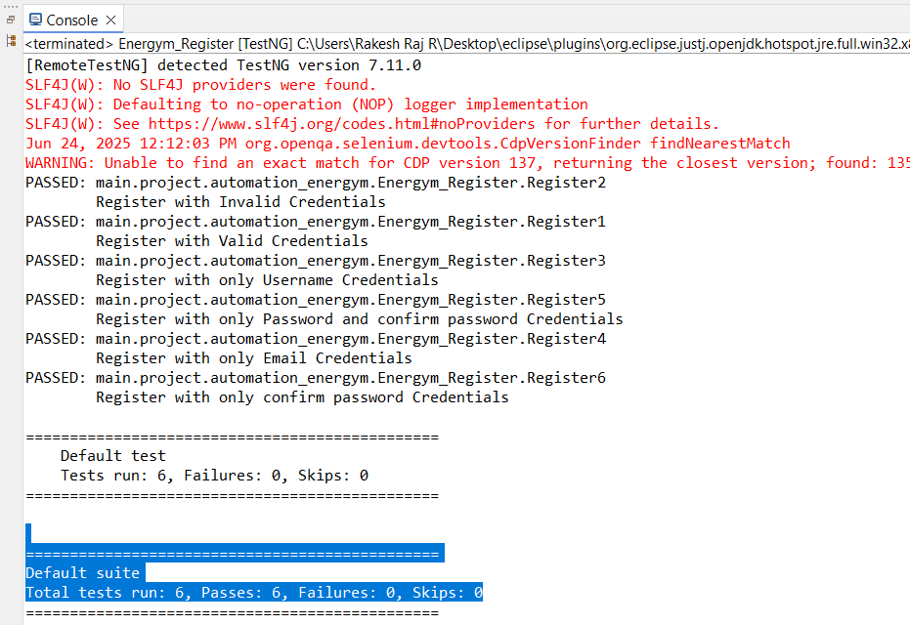

Slide 14
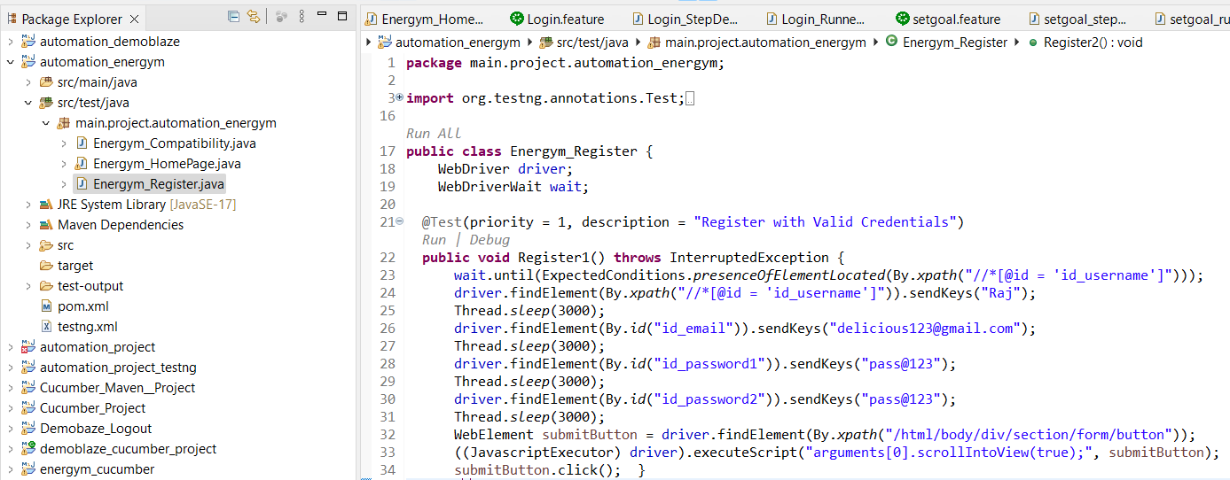
3. REGISTER

Slide 15
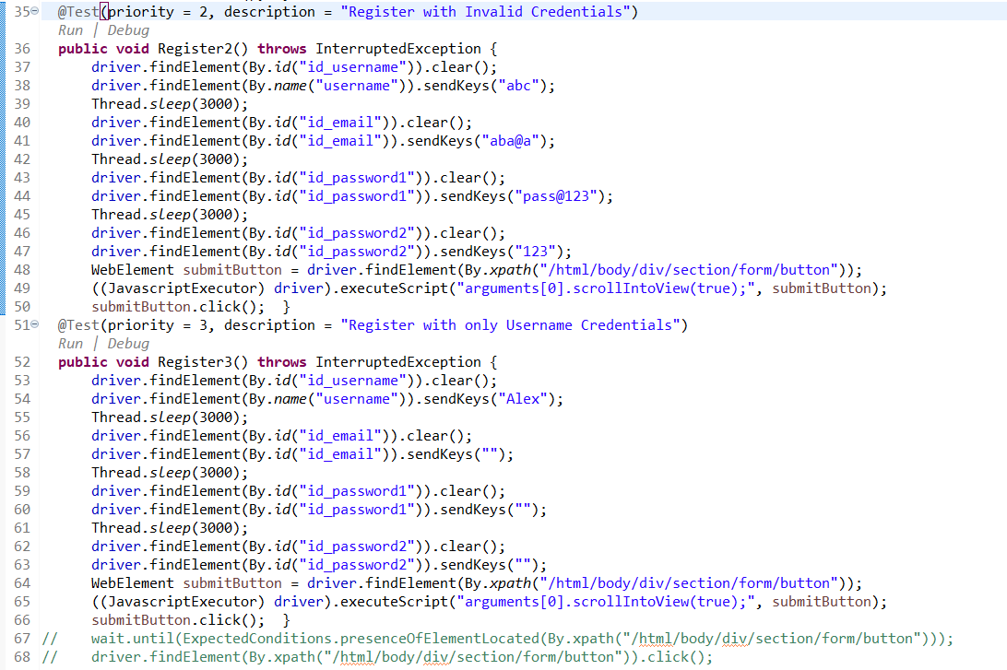

Slide 16
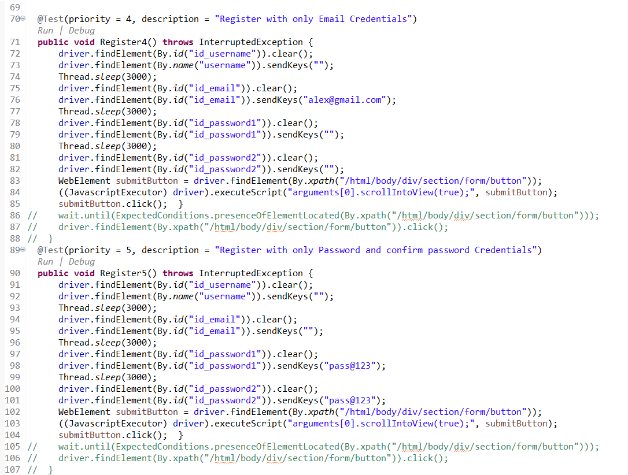

Slide 17
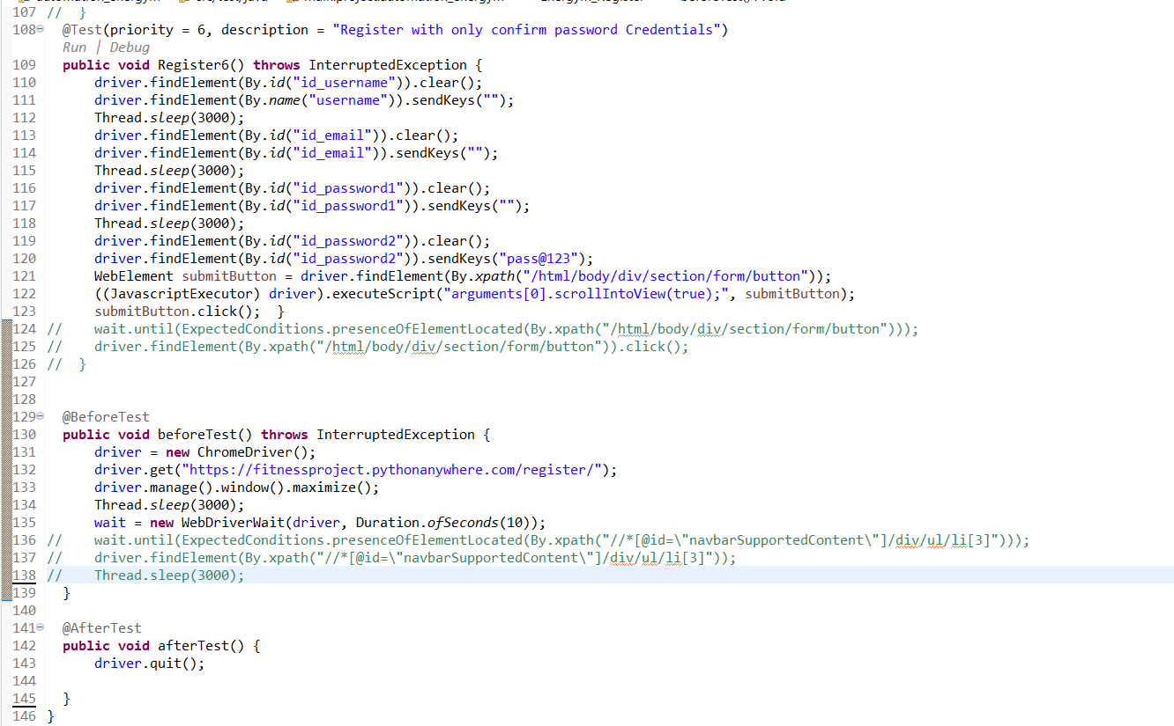

Slide 18
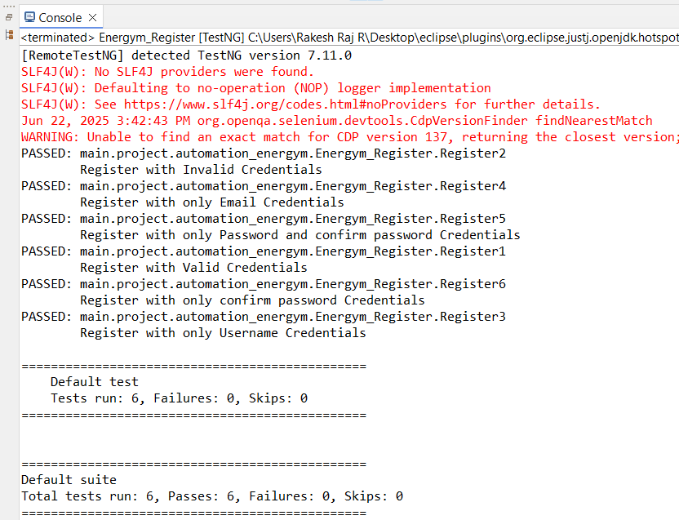

Slide 19
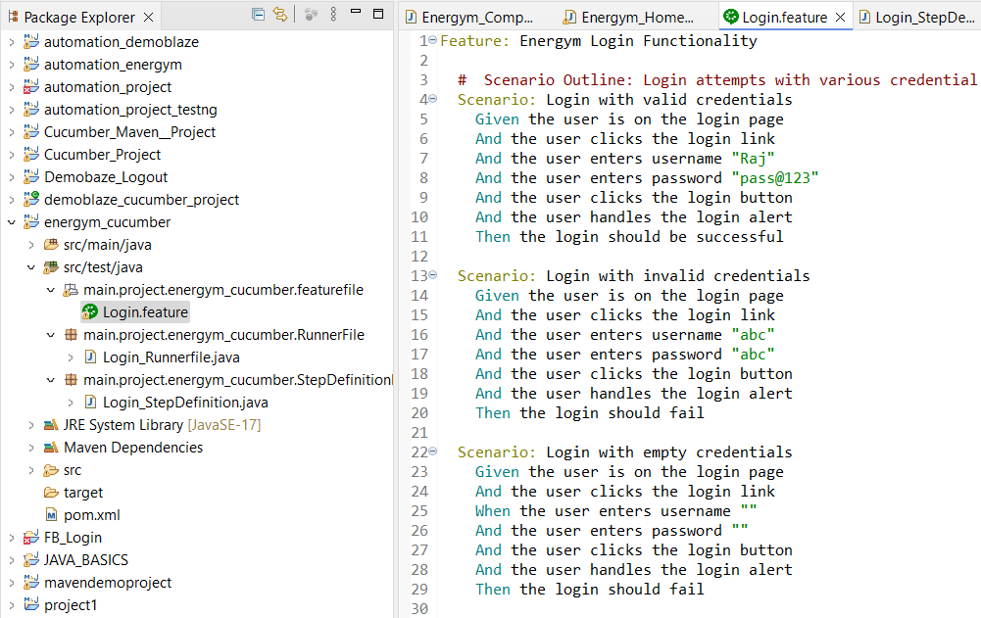
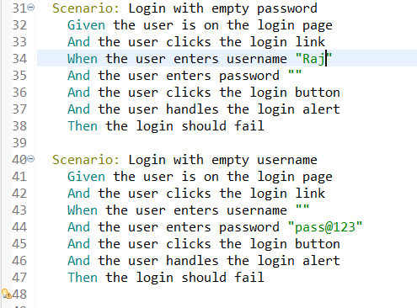
4. LOGIN

Slide 20
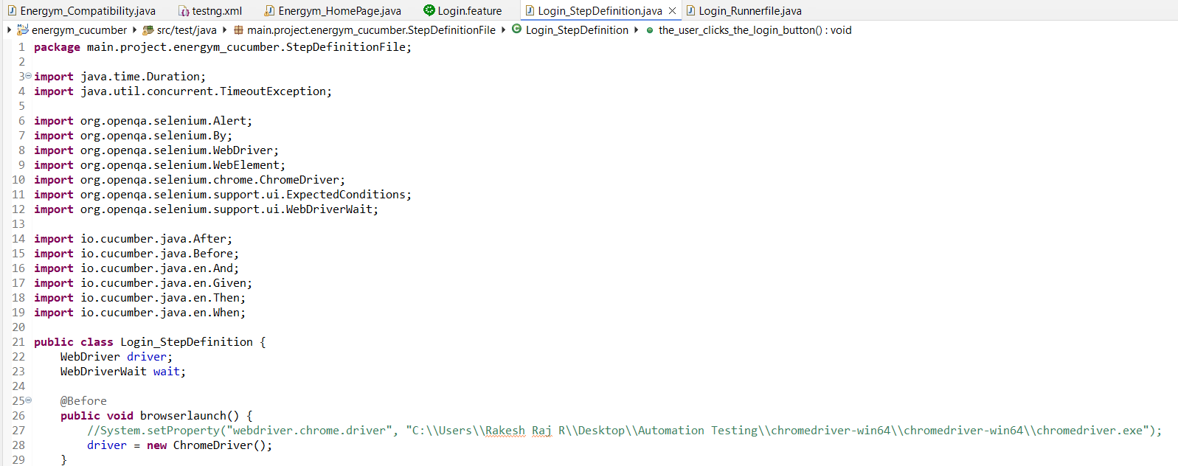

Slide 21
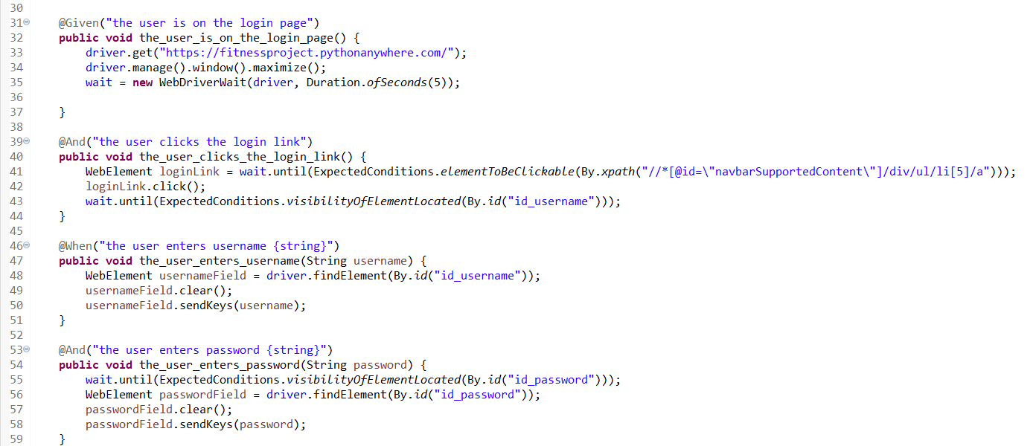

Slide 22
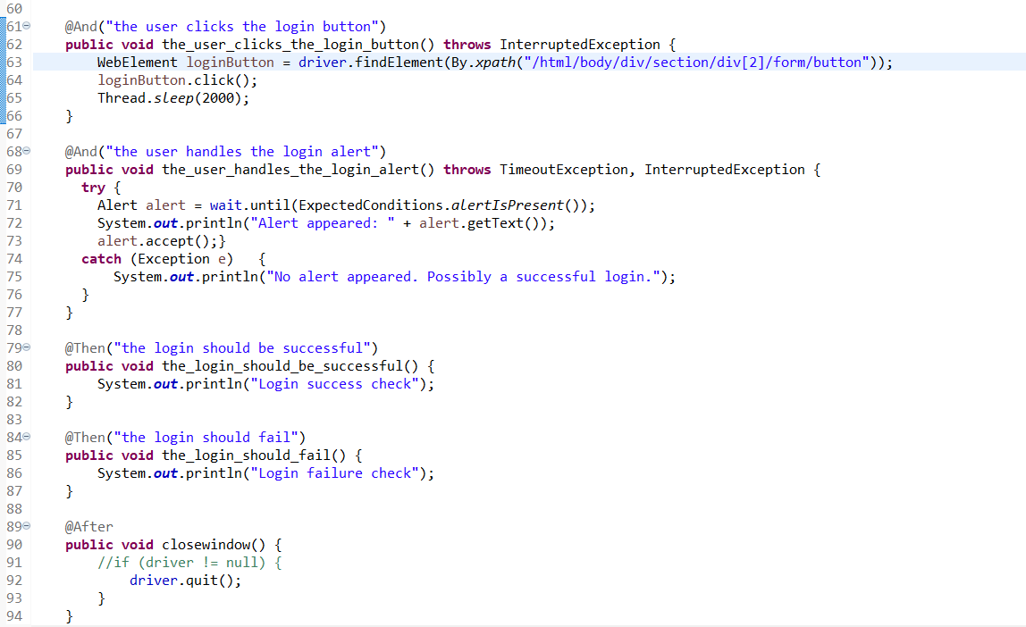

Slide 23
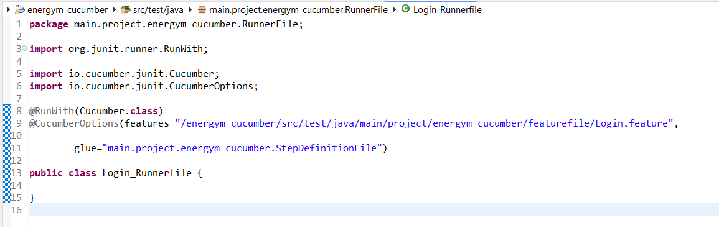
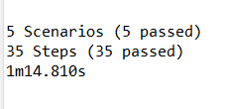

Slide 24
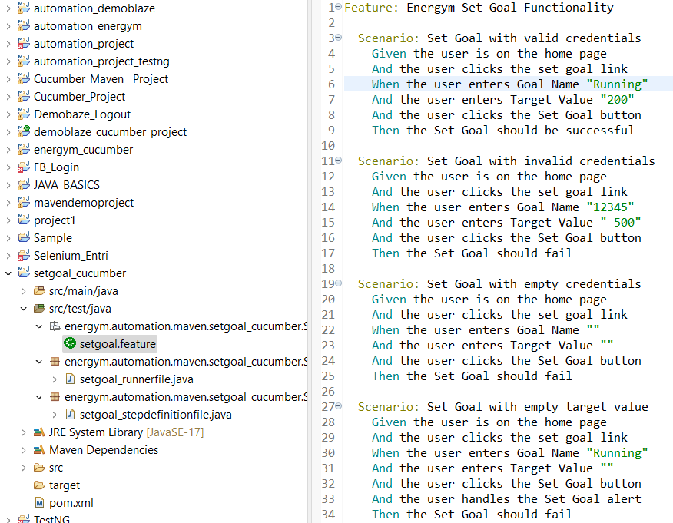
5. SET GOAL

Slide 25
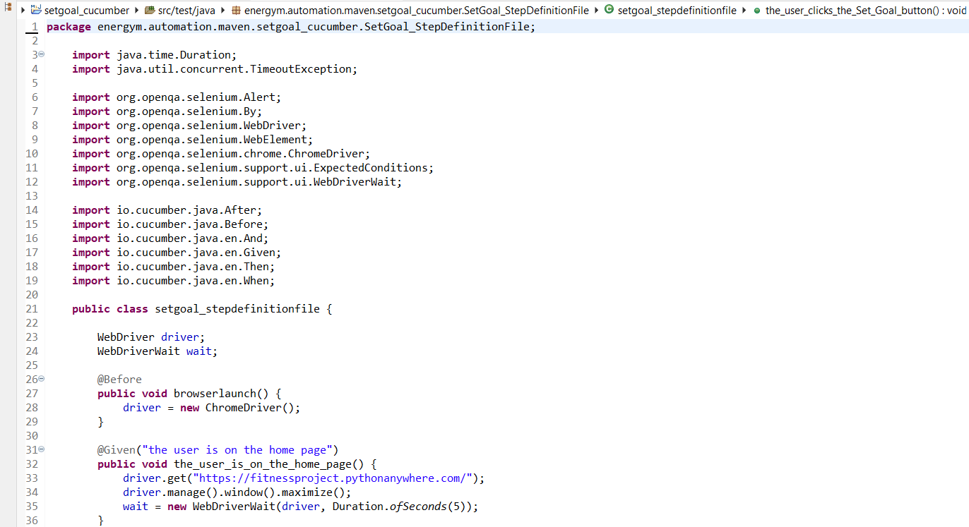

Slide 26
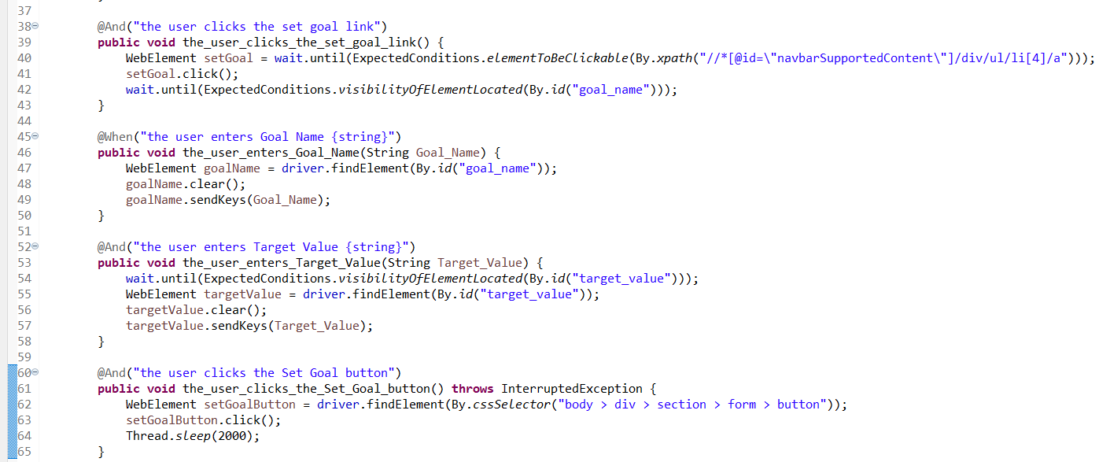

Slide 27
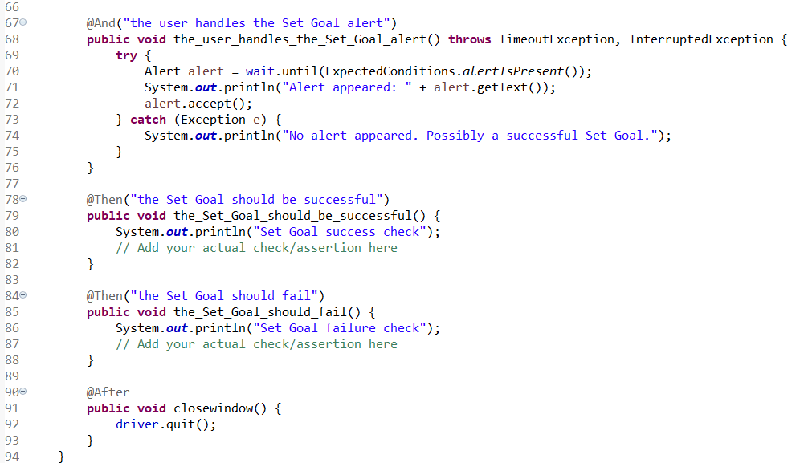
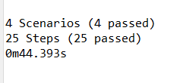

Slide 28
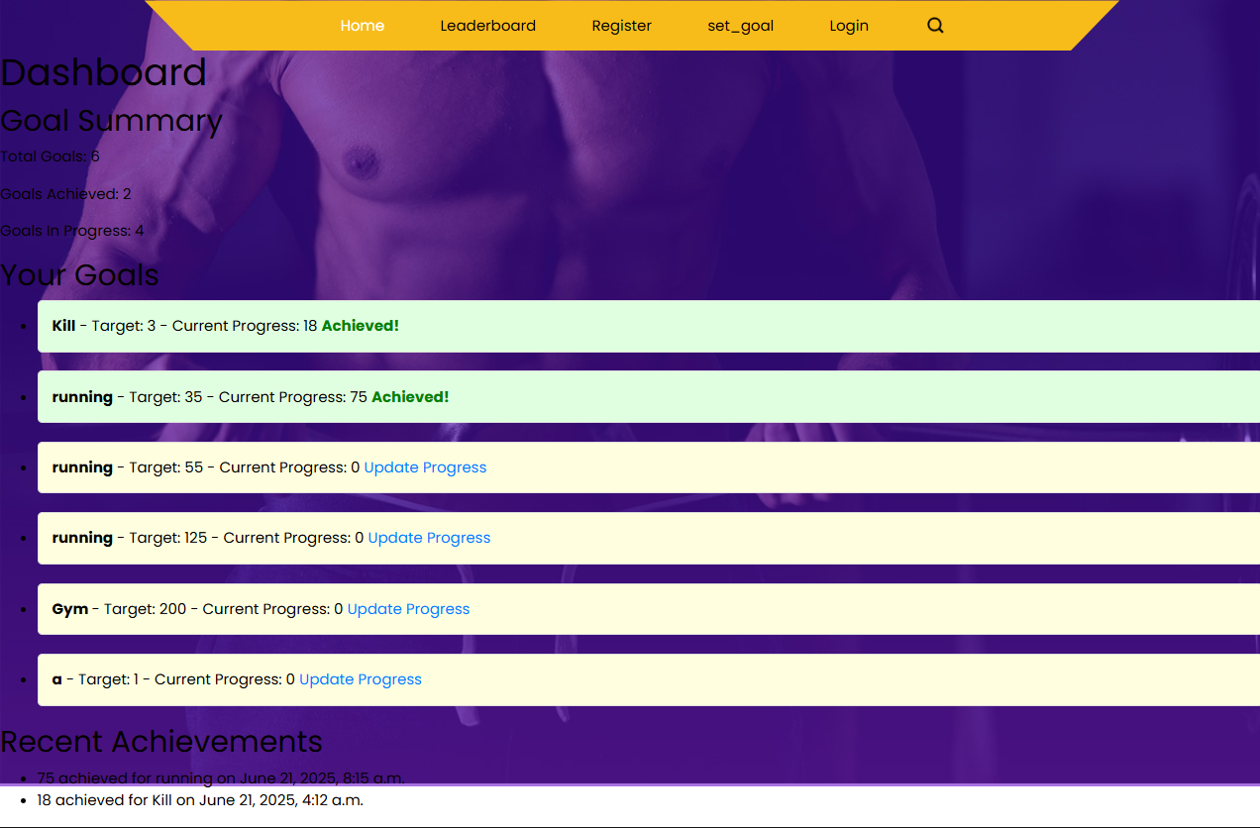

Slide 29
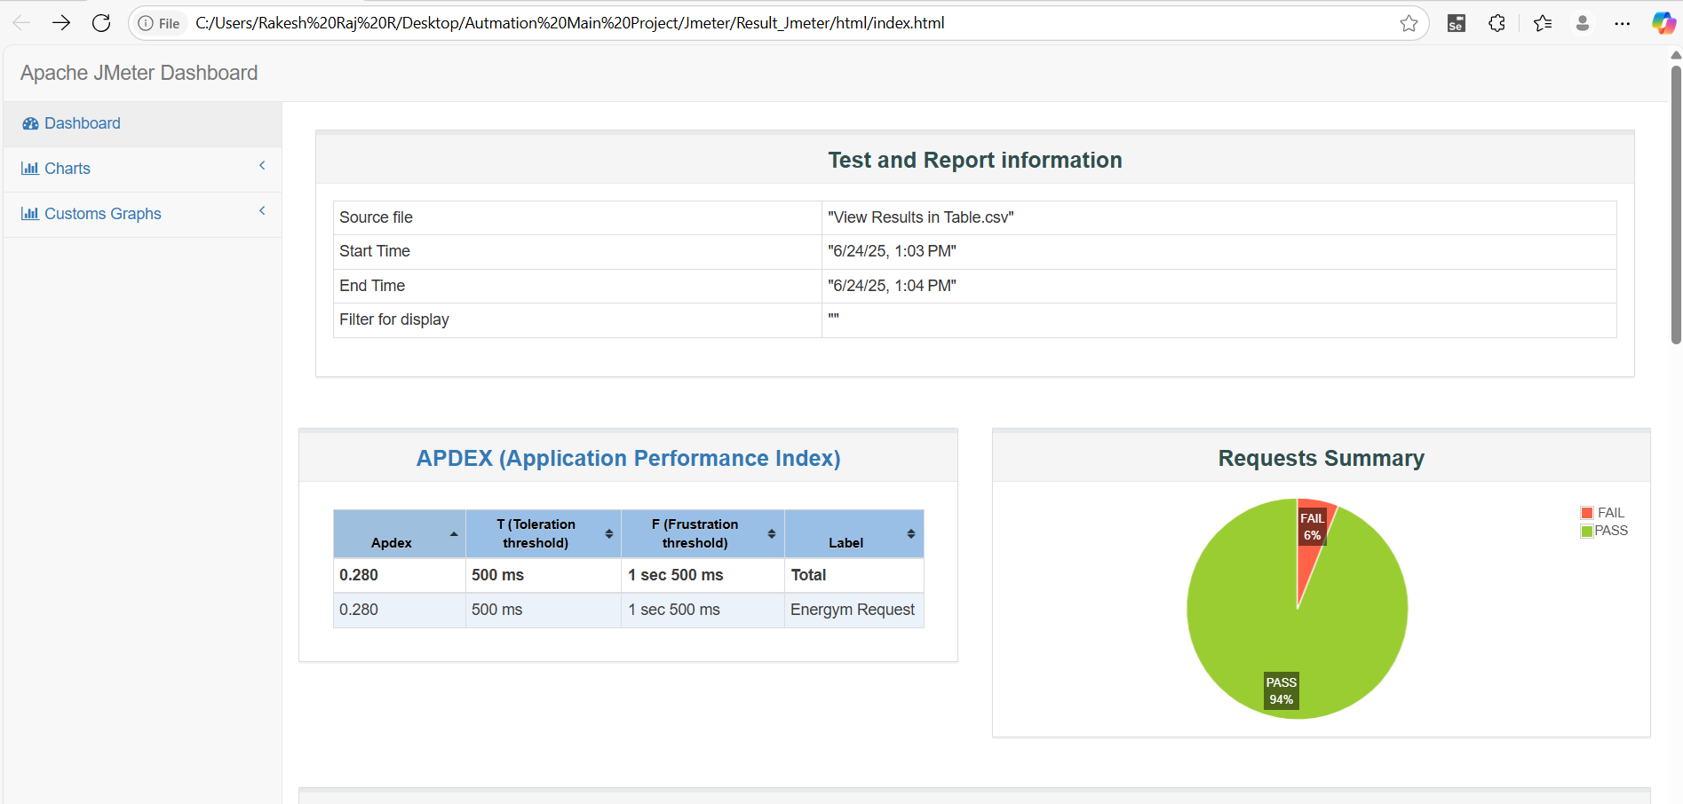
6. JMETER PERFORMANCE AND RESPOSIVENESS TESTING

Slide 30
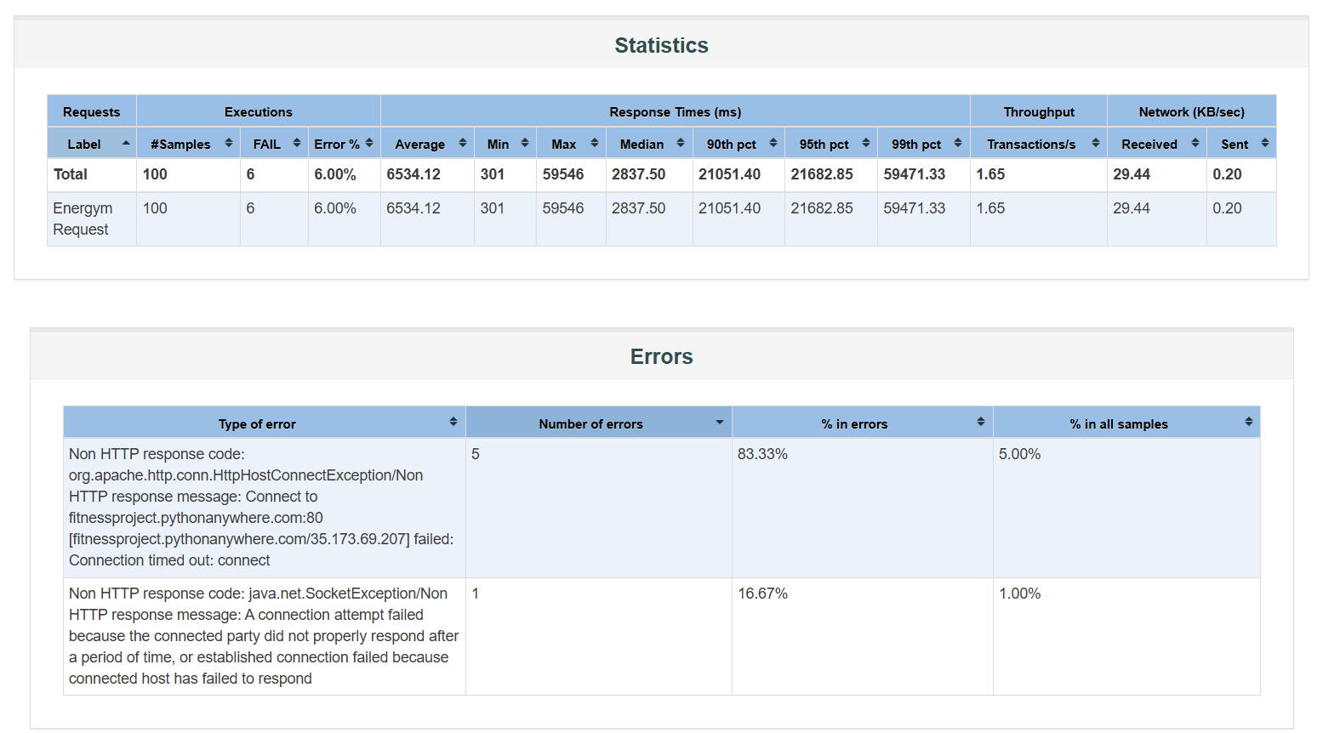

Slide 31
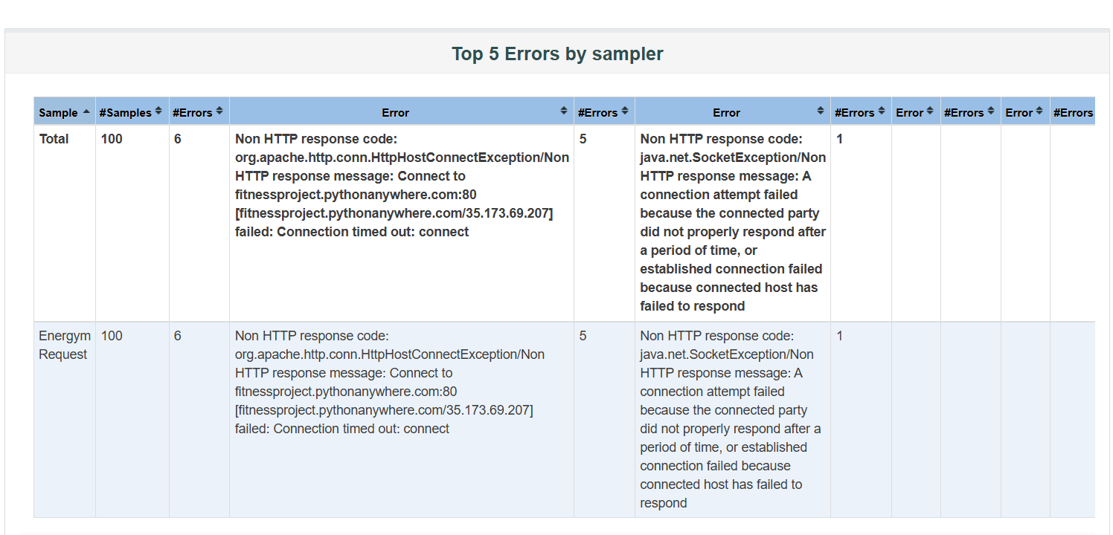

Slide 32
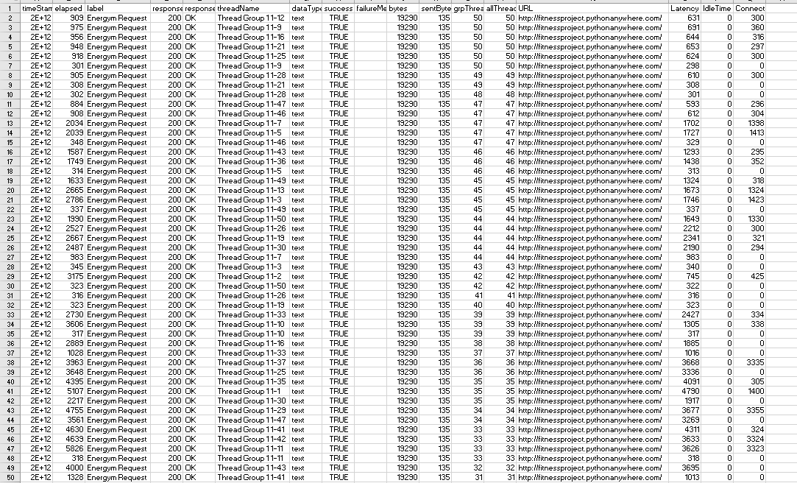

Slide 33
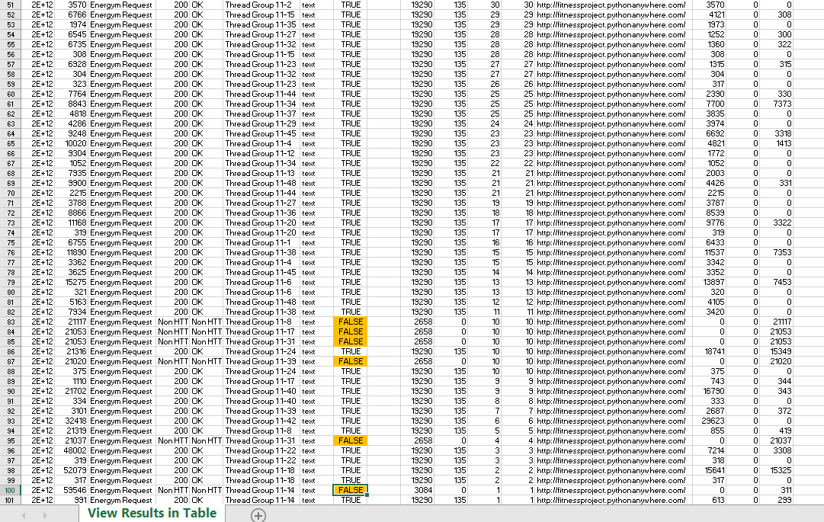

Slide 34
